Slide 1

SALARY PREDICTION USING REGRESSION
PRESENTED BY 2023-BSAI-004

Slide 2
Introduction
This project aims to develop a regression model that predicts employee salaries based on their years of experience. The goal is to explore how statistical modeling and data preprocessing can improve the accuracy of salary predictions, using a real-world-style dataset. The entire process includes data cleaning, feature transformation, modeling, and performance evaluation.

Slide 3
Dataset
Source: The dataset contains information about employees’ years of experience and their corresponding salaries.
Columns:
YearsExperience: A numeric feature representing how many years an individual has worked.
Salary: The annual salary earned.
Observations: Over 30 rows
Initial Insight: A scatter plot of the data showed a clear linear trend, suggesting a strong relationship
between experience and salary.

Slide 4





Preprocessing Steps
To prepare the dataset for accurate modeling, several preprocessing steps were performed:
Missing Values
Checked for null or missing values and removed any incomplete entries.
Outlier Detection & Removal
Applied the Interquartile Range (IQR) method to identify and exclude extreme salary values.
Feature Scaling
Standardized both YearsExperience and Salary using StandardScaler to normalize data distribution.
Dimensionality Reduction
Principal Component Analysis (PCA) was applied to reduce complexity, transforming YearsExperience into a lower-dimensional feature while retaining its variance.
Feature Selection
Used SelectKBest with f_regression to select the most relevant input feature for the model.

Slide 5
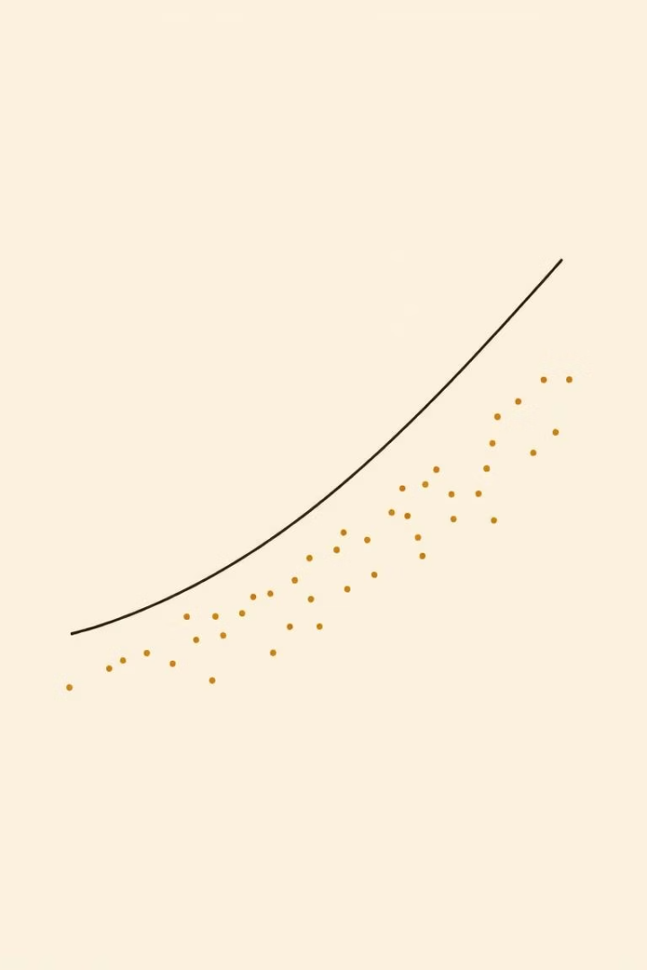
Modeling
Algorithm Used
Linear Regression
Train/Test Split
Data was divided into 80% training and 20% testing sets.
Training
The model was trained on the selected and transformed feature (YearsExperience_PCA) to predict scaled Salary.
Why Linear Regression?
Chosen due to the visible linear trend between years of experience and salary, making it appropriate for this type of analysis.

Slide 6
Evaluation
The performance of the model was assessed using standard regression metrics:
Mean Absolute Error (MAE)
Mean Squared Error (MSE)
Measures average absolute differences between predicted and actual values.
Penalizes larger errors by squaring the differences.
Root Mean Squared Error (RMSE)
R² Score
Easy to interpret as it's in the same unit as salary.
Indicates how well the model explains the variability of the target variable.
Example Results (rounded):
MAE: ~0.35
RMSE: ~0.42
R² Score: ~0.91 (Note: These values are based on scaled data.)

Slide 7





Key Findings
Strong positive correlation exists between years of experience and salary.
Data preprocessing—especially outlier removal and scaling—significantly improved model accuracy.
Even with a small dataset and simple features, careful preprocessing and feature selection led to a reliable model.
Dimensionality reduction using PCA helped simplify the model without sacrificing performance.

Slide 8

Conclusion
This regression project successfully demonstrated how to predict salaries using years of experience as a key factor. The combination of preprocessing, feature selection, and linear modeling produced accurate and interpretable results. The process also highlights the importance of data quality and transformation in machine learning workflows.

